Slide 1
Amplitude Modulation

Slide 2
Amplitude Modulation
Amplitude Modulation is a process where the amplitude of a carrier signal is altered according to information in a message signal.
The frequency of the carrier signal is usually much greater than the highest frequency of the input message signal.

Slide 3
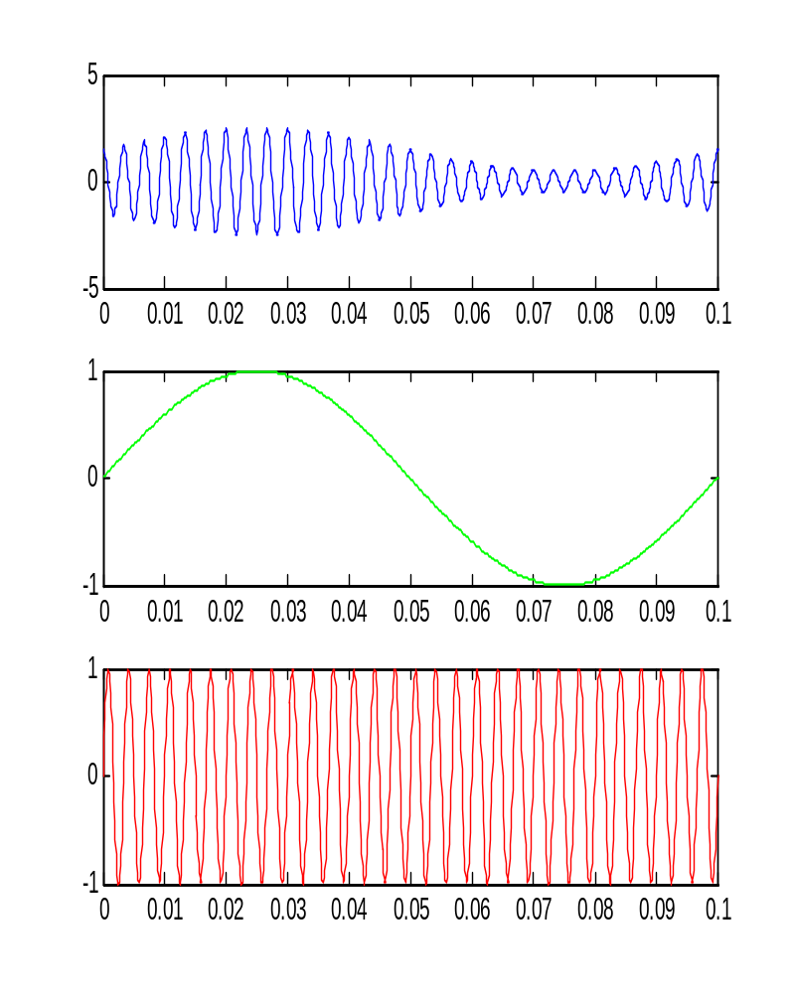
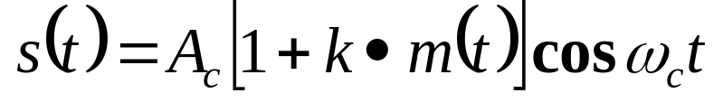
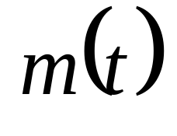
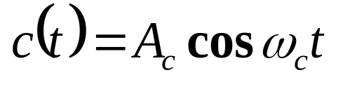
AM – Basic Definitions
The AM signal
The modulating signal:
The Carrier Signal:

Slide 4
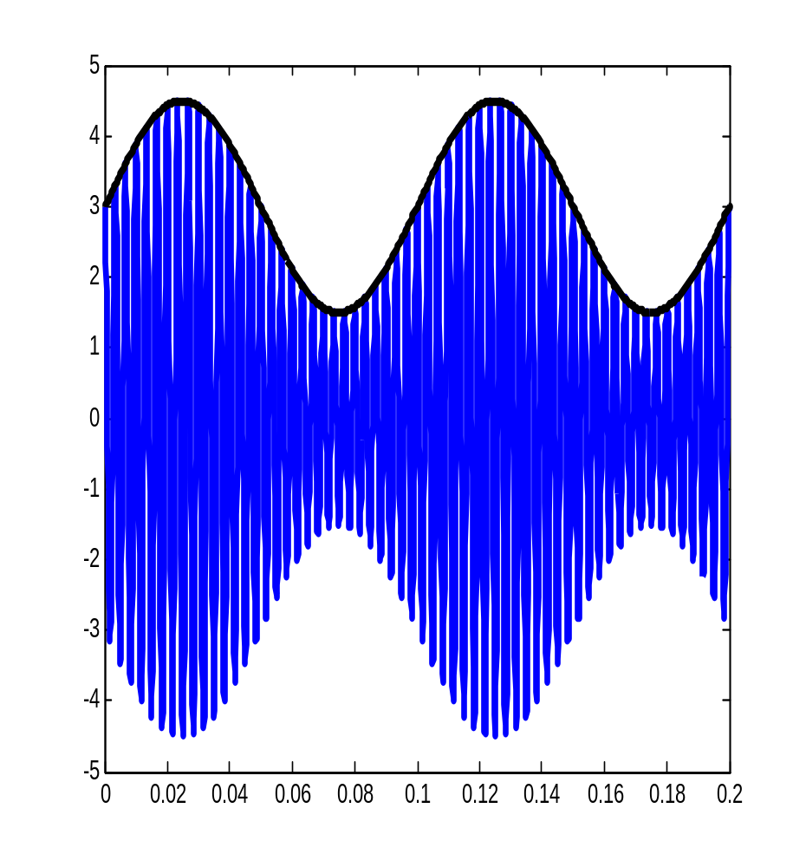
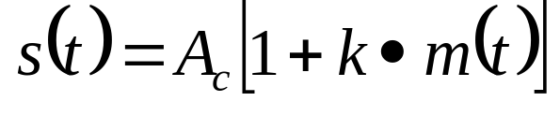

AM – Basic Definitions (cont.)
The Envelope:
The AM Signal

Slide 5
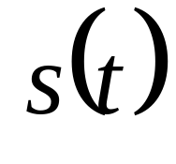
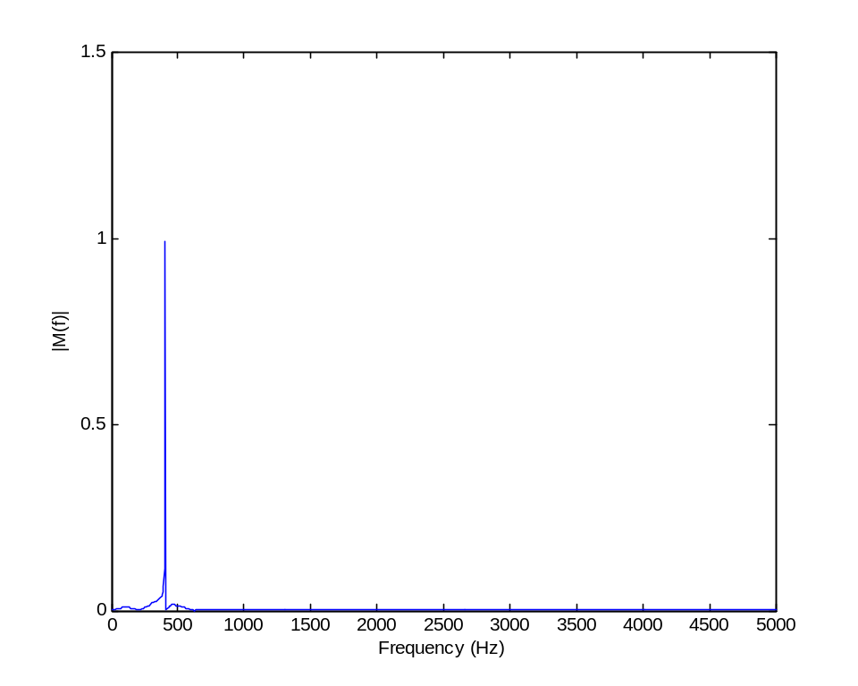
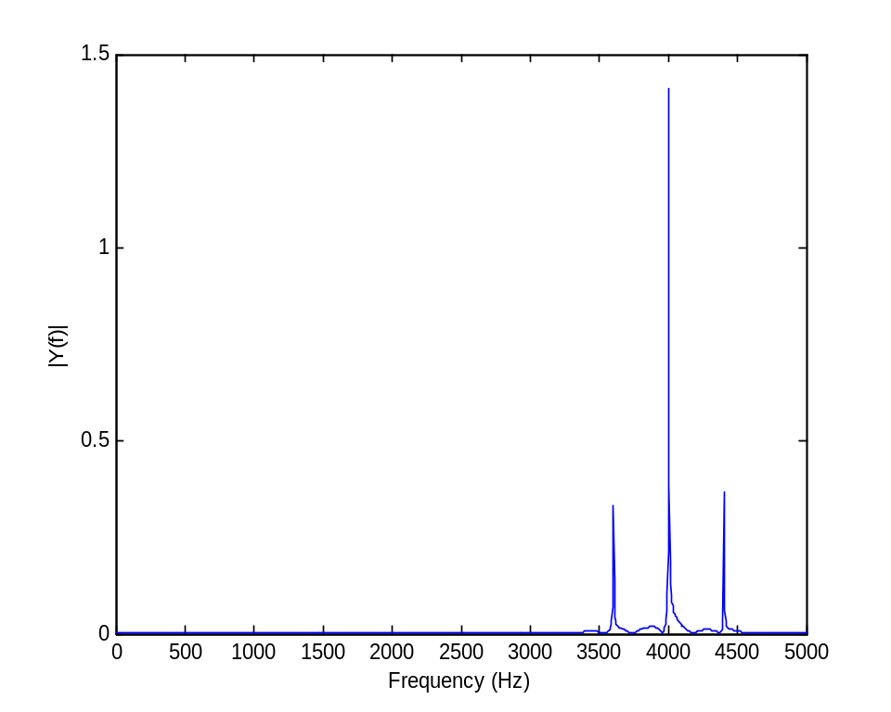
The AM Spectrum
Carrier
Side Bands

Slide 6
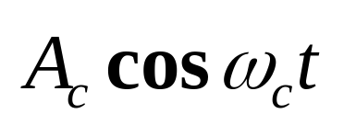
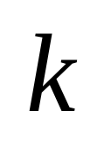

AM Modulation Scheme
+
X

Slide 7
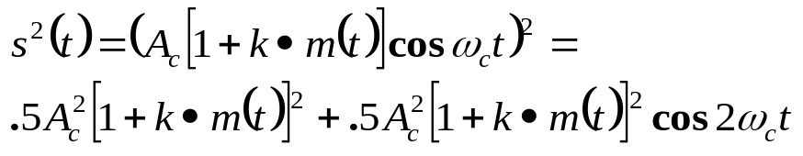
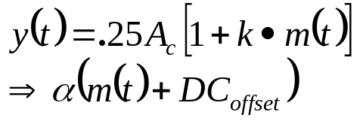
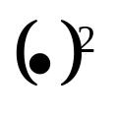
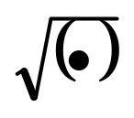
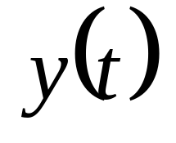

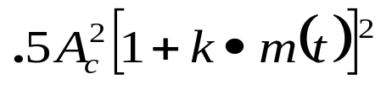
Square-Law Demodulation

Slide 8
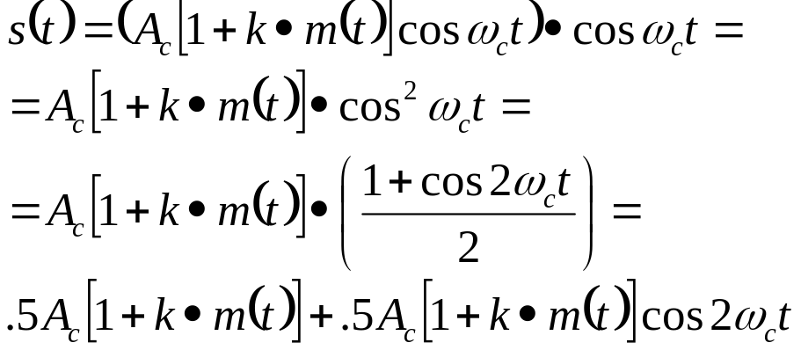
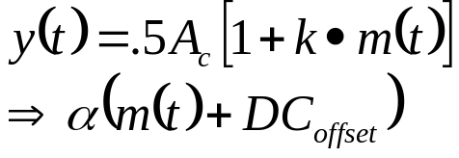
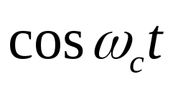
Coeherent Demodulation
X

Slide 9
Hands-On
Simulation
Implementation using the DSK6713

Slide 10
The Simulation Environment
Virtual
Scope
Modulator
Demodulator
Information
Signal
Demodulated
Signal

Slide 11
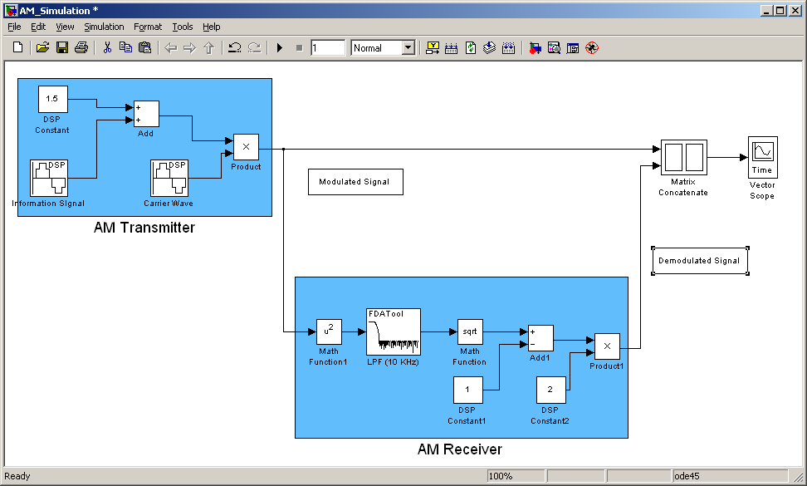
The Simulation Environment

Slide 12
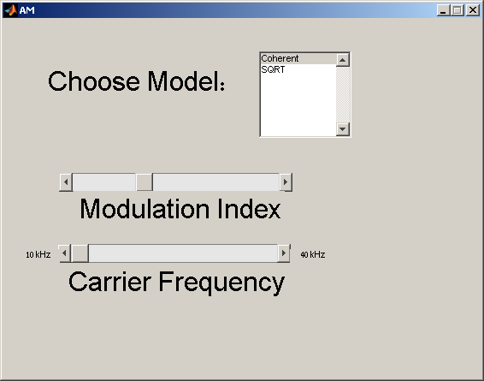

Real Time Environment
PC
RTDX
DSK6713
CODEC
TMS320C6713
AM
Modulator
Signal Generator
A/D
(Right)
D/A
(Left)
Line In
Line Out
Line Out
AM
Demodulator
Line In
Scope
D/A
(Right)
A/D
(Left)

Slide 13
GUI

Slide 14
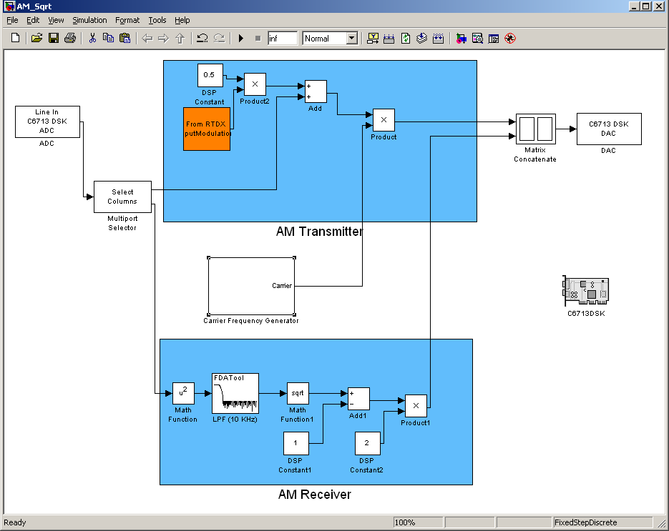
SQRT Detector – Real Time

Slide 15
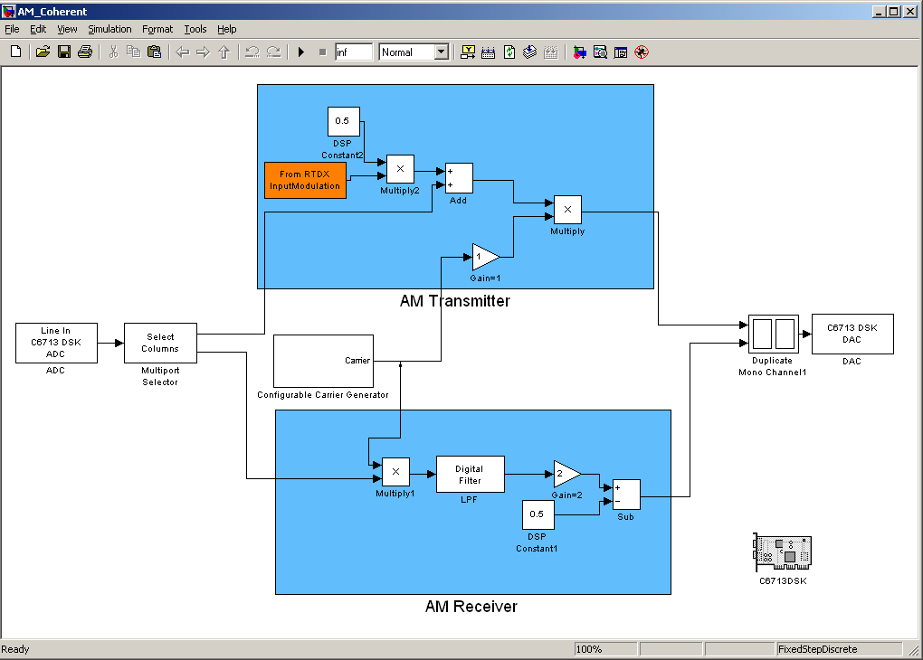
Coherent Detection – Real Time

Slide 16
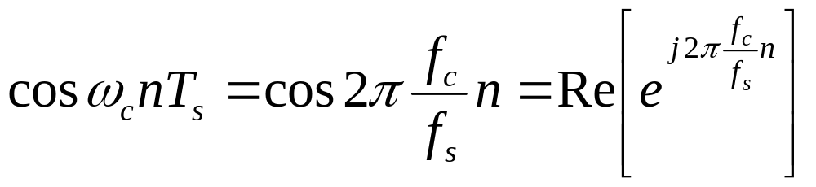
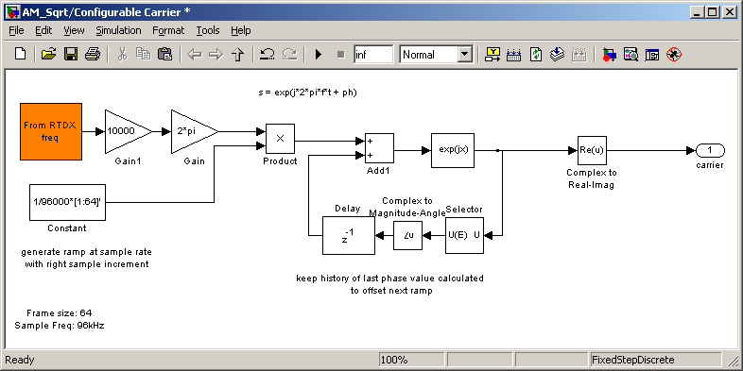
Configurable Carrier

